Slide 1
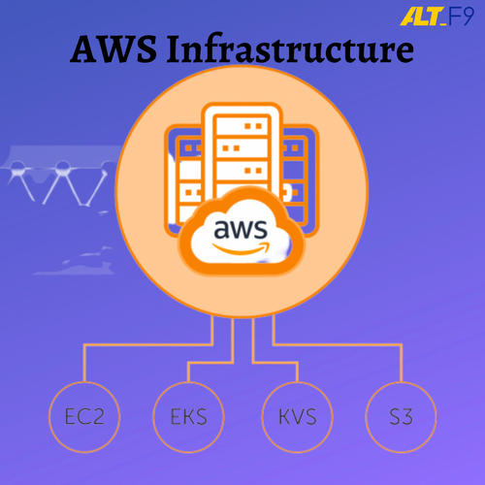
AUTOMATE INFRASTRUCTURE IN AWS CLOUD
TEAM No:62
19P31A05A6-Kamalatha
19P31A0581-Swetha
19P31A05A5-Sai Lakshmi
19P31A0588-Jyothi

Slide 2

AWS (Amazon web services)

Slide 3
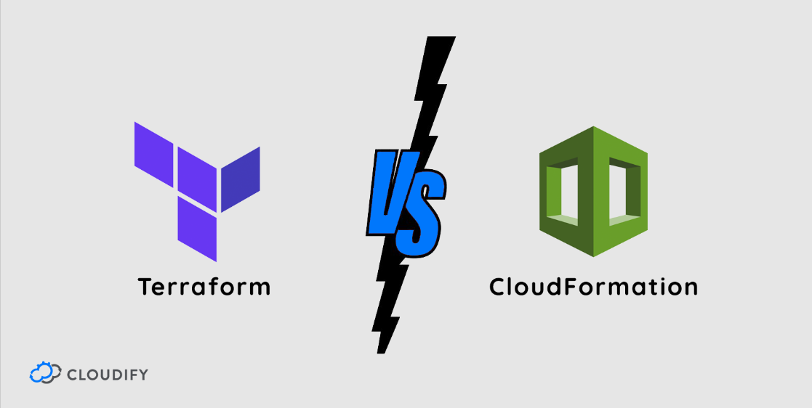
AUTOMATE INFRASTRUCTURE IN AWS CLOUD
Infrastructure automation is the use of technology that performs tasks with reduce human assistance in order to control the hardware.
There are two ways to automate the infrastructure
1.Cloud formation(Internal Service provided by the aws)
2.Terraform (External tool)

Slide 4

CLOUD FORMATION
AWS Cloud Formation is a service that helps you model and set up your AWS resources so that you can spend less time managing those resources that run in aws.
You create a template that describes all the AWS resources that you want (like Amazon EC2 instances ).
Cloud Formation takes care of provisioning and configuring those resources for you. You don't need to individually create and configure AWS resources.

Slide 5
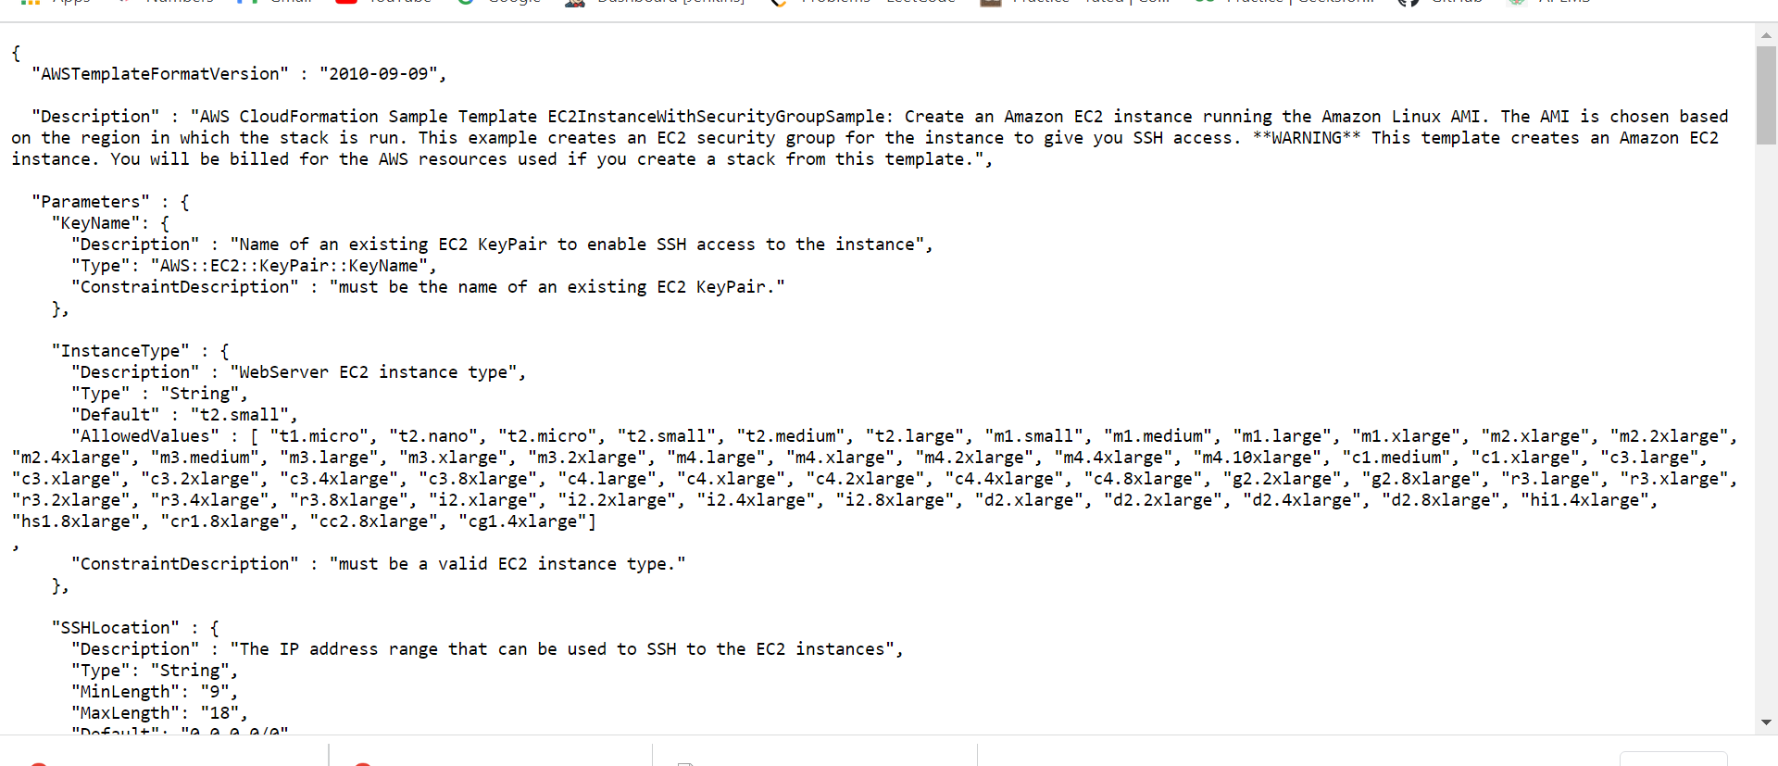
CLOUD FORMATION SAMPLE TEMPLATE FOR AUTOMATE EC2 INSTANCE

Slide 6
DRAWBACKS OF CLOUD FORMATION
It is not possible to 100% check a template locally, it is only possible to be certain of syntactic correctness without first executing it.
Cloud formation is confined only to aws.We can’t use other cloud service platforms like azure, kubernetes etc.. Because it is internal service of aws.
At least, not always; in fact, there are many configurations and/or resources that cannot be specified in an AWS CloudFormation template.

Slide 7
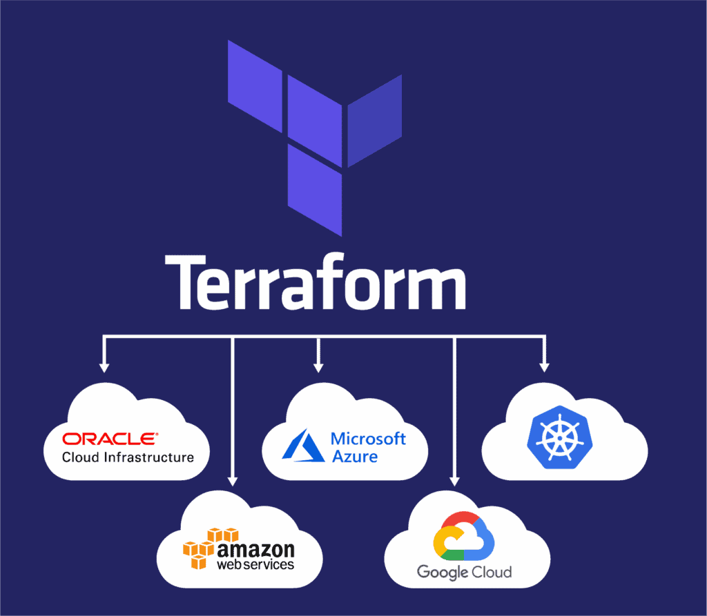
TERRAFORM
Terraform is a open-source, and it is a tool to manage entire infrastructure using infrastructure as code.
Terraform supports all cloud vendors like aws, azure, kubernetes and many other.
Terraform is a declarative nature. It directly defines end state of the system.

Slide 8
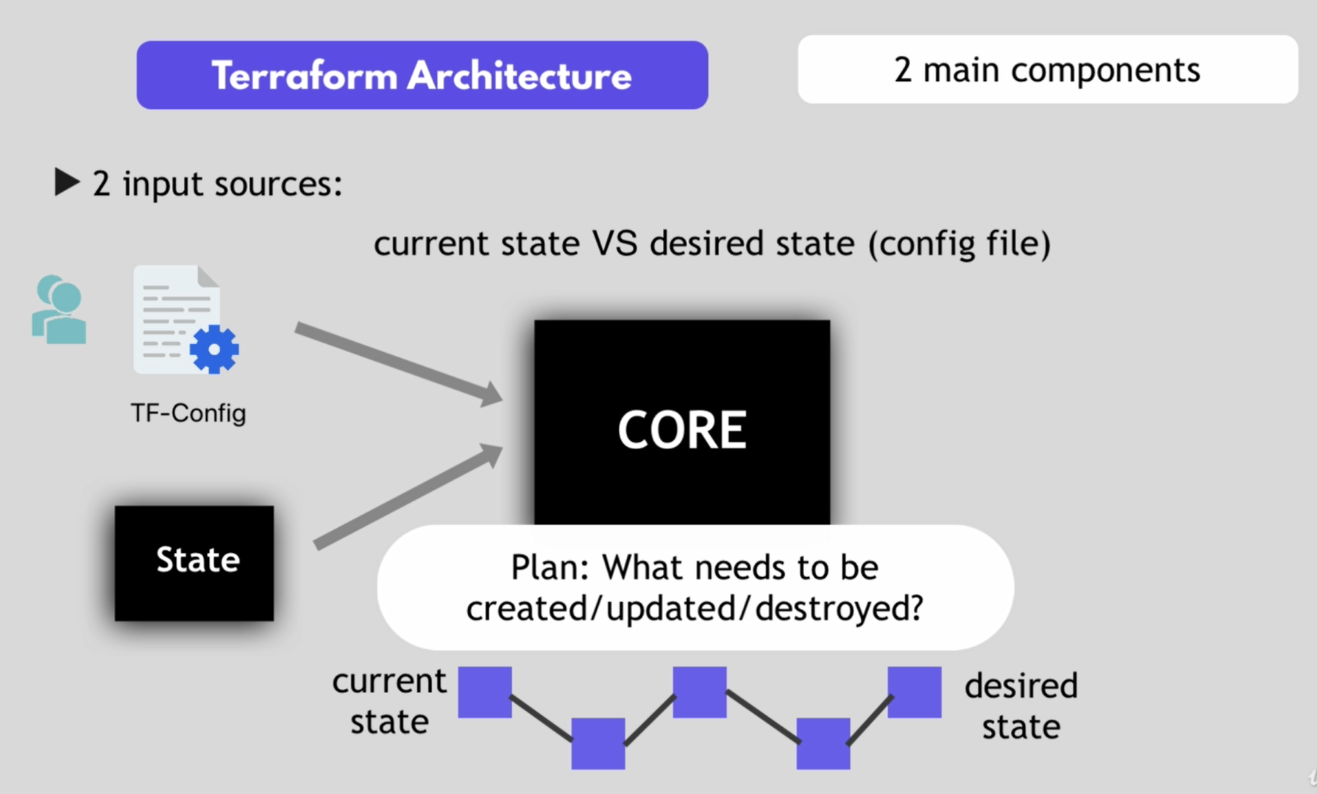
Terraform is a tool for creating infrastructure . It builts to automate the provisioning of infrastructure resources.
It is used to built for manage, update infrastructure resources like virtual machines,networking and others..
TERRAFORM ARCHITECHTURE

Slide 9
ARCHITECTURE COMPONENTS
Terraform is the code tool. It defines the resources and infrastructure in human readable declarative configuration files.
Terraform architecture is having 2 main components
CORE-it is having 2 input sources
State And TF configuration file
User need to define what needs to be created, update, destroy.
PROVIDERS :
Provider is just code that knows how to communicate to specific technology or platforms.
Some of the platforms are like aws,azure,kubernets.

Slide 10
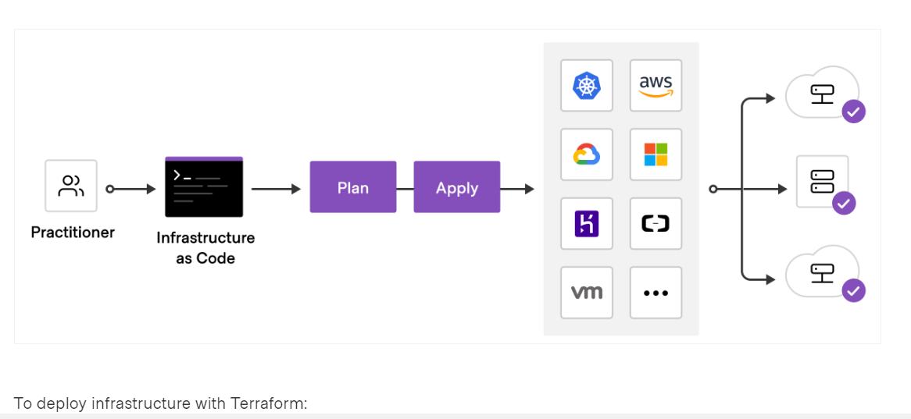
How terraform works!

Slide 11
TERRAFORM COMMANDS
init
The terraform init command is used to initialize a working directory containing Terraform configuration files..
plan
creates an execution plan, which lets you preview the changes that Terraform plans to make to your infrastructure.
Apply
It executes the actions proposed in a terraform plan.
Destroy
terminates resources defined in your Terraform configuration. This command is the reverse of terraform apply in that it terminates all the resources specified by the configuration. It does not destroy resources running elsewhere that are not described in the current configuration.

Slide 12
ADVANTAGES: 1. Terraform can manage infrastructure on multiple cloud platforms. 2. The human-readable configuration language helps you write infrastructure code quickly. 3. Terraform's state allows you to track resource changes throughout your deployments. 4. No need to remember the current state. 5. Terraform is an idempotent. 6. provider translates config file to something that aws API understands.

Slide 13
THANK YOU

